Slide 1
Sentiment Analysis of Arabic Tweets

Slide 2
The group of project
Students
Abdullah Rashed Alqahtani
Meshary Abdullah Alyami
Youssef Mohamed Abdelhamid
Supervisor
Dr. Bandar Almaslukh
Prince Sattam Bin Abdulaziz University
College of Computer Engineering and sciences Dep Computer Sciences
Dec 2021

Slide 3
Introduction
1

Slide 4
Sentiment Analysis
Sentiment Analysis is also known as opinion mining. It is a method for analyzing texts based on their context and meaning to identify the emotional tone behind a body of text or categorize opinions about a product, service, or idea.
Used in NLP (Natural Language Processing).
NLP is techniques that include calculating, analyzing and representing texts to understand the nuances of language.

Slide 5
Description of the problem
Given an Arabic tweet T, the problem statement can be formulated as developing an effective model M to classify this Arabic tweet into positive or negative using supervised machine learning methods L.

Slide 6
Arabic Sentiment Analysis Challenges
Even though there are some Arabic sentiment analysis tools and methods, but there is a set of challenges such as:
The number of studies is still limited.
The complexity of Arabic words such as:
Formatting.
Different meanings.
Many dialects.

Slide 7
Sentiment Analysis Steps
2

Slide 8
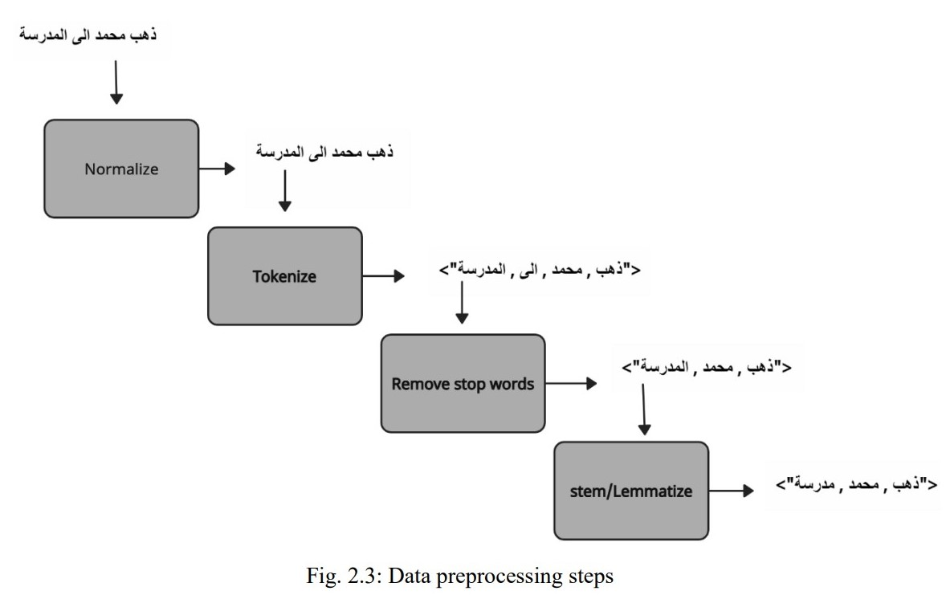
Cleaning and Pre-processing
Cleaning and pre-processing is the first step of sentiment analysis after collecting data text from the source. It contains a number of sub-steps shown in Fig. 2.3 below.

Slide 9
Feature Extraction and Representaion
After the pre-processing process, a number of algorithms are applied to represent the words and extract features such as:
TF.IDF (Classical Model).
Bag of words (Classical Model).
Word2vec.
Glove.

Slide 10
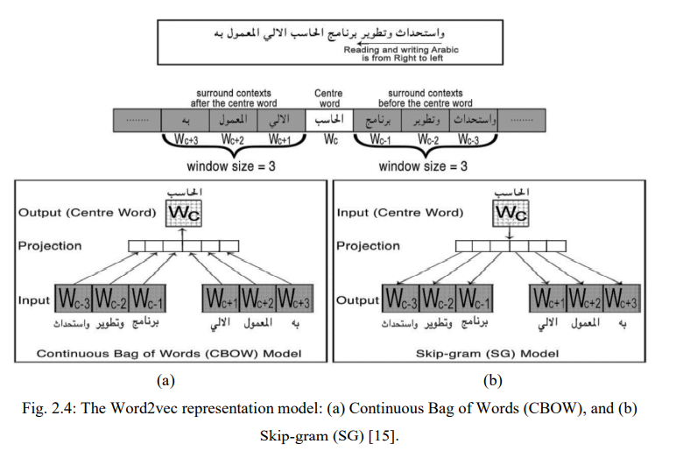
Feature Extraction and Representaion (Cont.)
Representation Learning
Word2Vec model using two different architectures:
Continuous Bag of Words (CBOW)
It is trained by trying to predict a target word giving a specific context
Model Skip-gram (SG) Mode
is given a specific word and tries to predict its context

Slide 11
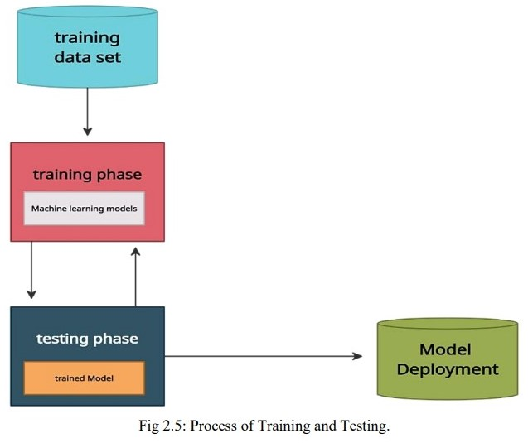
Machine Learning Training and Testing
After applying the algorithms, we reach the stage of training and evaluating the model. This is done by dividing the data into 80% for training and 20% to ensure the quality of the model and its accuracy in prediction, and the next figure will explain that.

Slide 12
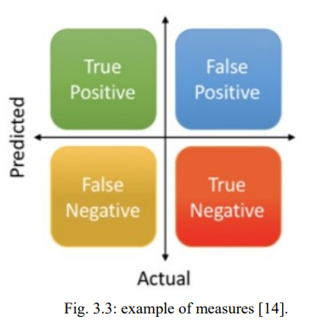
Results Evaluation
We evaluate every algorithm by Some measures
Precision = True Positives / (True Positives + False Positives) •
Recall = True Positives / (True Positives + False Negatives) •
F-Measure = (2 * Precision * Recall) / (Precision + Recall) •
Accuracy = (True positive + True negative) / Total .

Slide 13
Literature Review
3

Slide 14
Dataseats
A number of datasets related to the same topic of our project was studied and information was known about it, such as its numbers, date and classifications, to get a comprehensive idea of ​​the topic.

Slide 15
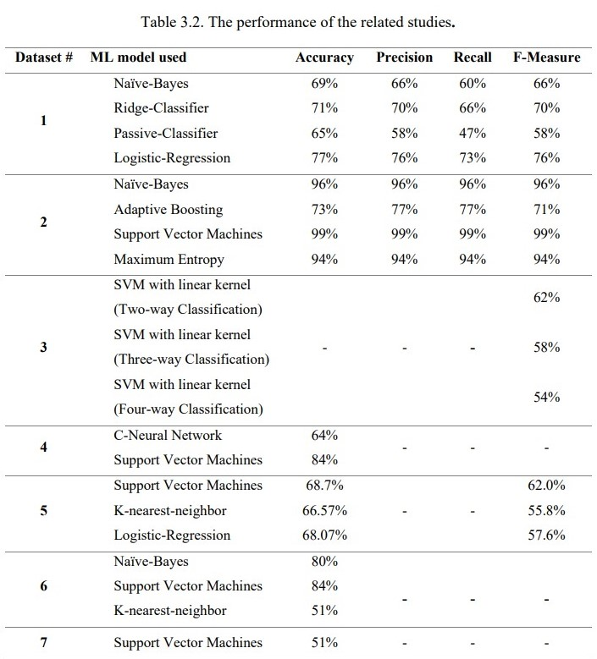
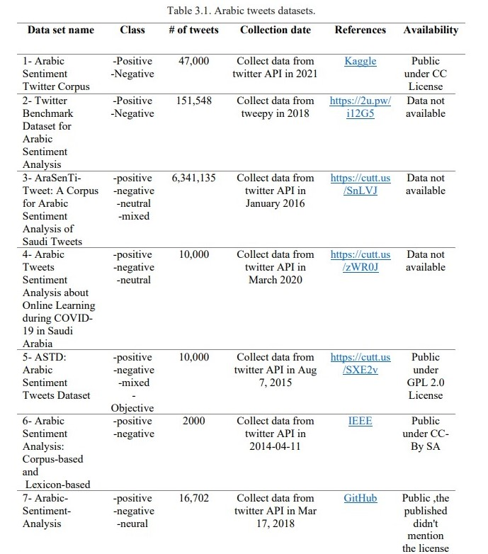
Dataseats (cont.)

Slide 16
Proposed methodology
4

Slide 17
Workflow
Our methodology aims to classify tweets into negative and positive after they have been preprocessed, extract their features and use a number of machine learning methods and The idea will be illustrated by the following figure.

Slide 18
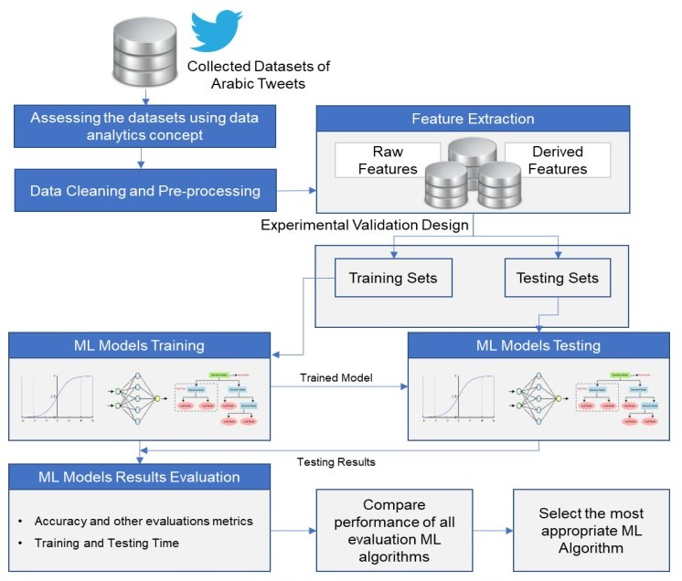
Workflow (cont.)

Slide 19
Conclusion
5

Slide 20
Conclusion
Finally, we worked on using sentiment analysis on Twitter’s tweets due to the large number of users and the large number of tweets, and to enhance the correct understanding of the meanings in machines, and we faced a number of difficulties such as collecting data and understanding algorithms accurately.

Slide 21
Thanks!
Any questions ?

